Slide 1
COMP 282 Lecture 02: Asymptotic Analysis Mahdi Ebrahimi

Slide 2
Announcement
HW 01 (Linked List Review) due Thursday 7/16 11:59pm

Slide 3
Lecture Outline
Overview: Algorithmic Analysis
Code Modeling
Asymptotic Analysis
Big-O, Big-Omega, Big-Theta
Case Study: Linear Search

Slide 4
Why Efficient Code?
Computers are faster, have larger memories
So why worry about efficient code?
And … how do we measure efficiency?

Slide 5
Example – Sum of First n Values
Consider the problem of summing
n
Σ i = 1 + 2 + 3 + … + n
i=1
How would we code this?

Slide 6
Example – Sum of First n Values
n
Σ i = 1 + 2 + 3 + … + n
i=1
Approach A:
sum = 0;
for (i = 1; i <= n; i++)
sum = sum + i;
Approach B:
sum = 0;
for (i = 1; i <= n; i++)
for (j = 1; j <= i; j++)
sum = sum + 1;
Approach C:
sum = n * (n+1) / 2

Slide 7
Sum of First n Numbers
public static void main(String[] args){ long n = 10000;
long sum = 0;
// Algorithm A
for (long i = 1; i<= n; i++) sum = sum + i;
System.out.println("Sum is " + sum);
// Algorithm B
sum = 0;
for (long i = 1; i <= n; i++) for (long j = 1; j <= i; j++)
sum = sum + 1; System.out.println("Sum is " + sum);
// Algorithm C
sum = n * (n + 1) / 2; System.out.println("Sum is " + sum);
}

Slide 8
What is "best"?
An algorithm has both time and space constraints – that is complexity
Time complexity
Space complexity
This study is called analysis of algorithms

Slide 9
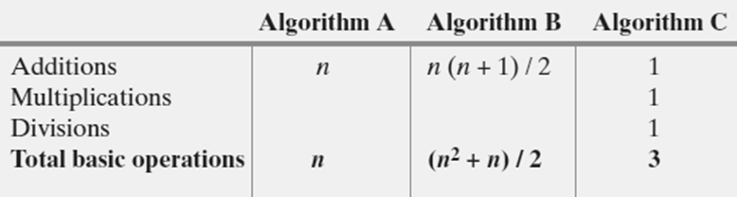
Counting Basic Operations
A basic operation of an algorithm
The most significant contributor to its total time requirement
Number of required basic operations

Slide 10
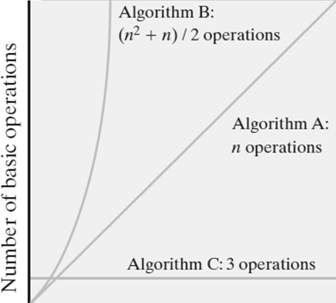
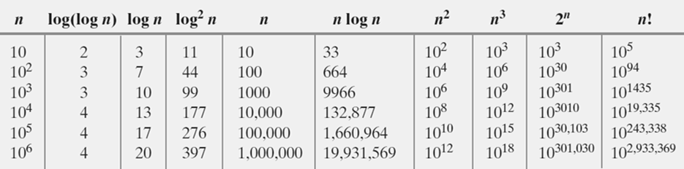
Counting Basic Operations
Number of basic operations required by the algorithm
Typical growth-rate functions evaluated at increasing values of n

Slide 11
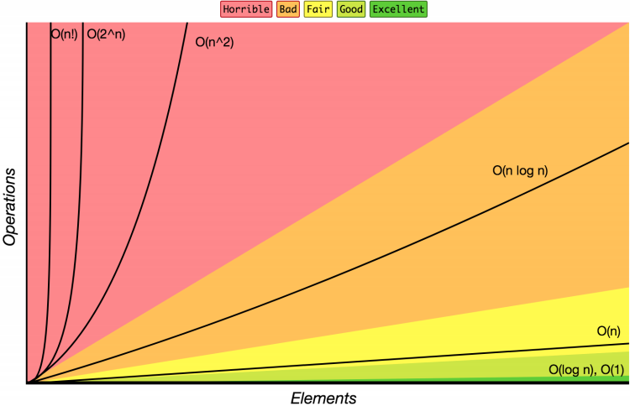
Complexity Class
Complexity Class: a category of algorithm efficiency based on the algorithm’s relationship to the input size N
Complexity Class | Big-O | Runtime if you double N
constant | O(1) | unchanged
logarithmic | O(log₂ N) | increases slightly
linear | O(N) | doubles
log-linear | O(N log₂ N) | slightly more than doubles
quadratic | O(N²) | quadruples
... | ... | ...
exponential | O(2^{N}) | multiplies drastically
Notes:
Big Oh: A function f(n) is of order at most g(n)

Slide 12
Big-Oh Analysis: Why?
 | ArrayList | LinkedList
add (front) | O(n) linear | O(1) constant
remove (front) | O(n) linear | O(1) constant
add (back) | O(1) constant usually | O(n) linear
remove (back) | O(1) constant | O(n) linear
get | O(1) constant | O(n) linear
Insert (anywhere) | O(n) linear | O(n) linear
Complexity classes help us differentiate between data structures
“Just change first node” vs. “Change every element” is clearly different
To evaluate data structures, need to understand impact of design decisions

Slide 13
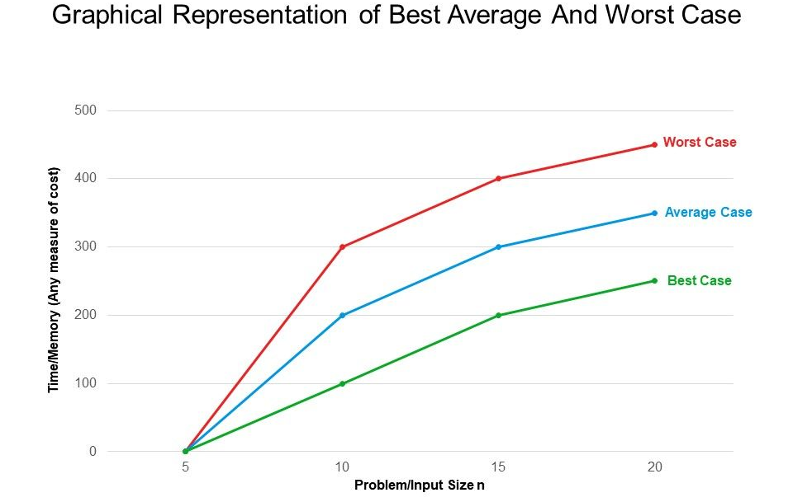
Best, Worst, and Average Cases
For some algorithms, execution time depends only on size of data set
Other algorithms depend on the nature of the data itself
Here we seek to know best case, worst case, average case

Slide 14
Big-Oh Analysis: Why?
We need a tool to analyze code, and we want it to be:
A
Simple
We don’t care about tiny differences in implementation, want the big picture result
B
Mathematically Rigorous
Use mathematical functions as a precise, flexible basis
Decisive
Produce a clear comparison indicating which code takes “longer”
C

Slide 15
Big-Oh Analysis: ... How?!
CODE
BIG-OH
?
for (i = 0; i < n; i++) {
a[i] = 1;
b[i] = 2;
}
O(n)
general patterns: “O(1) constant is no loops, O(n) is one loop, O(n²) is nested loops”
This is still useful!
But in the future algorithm courses, you’ll go much more in depth: you will learn more about why, and how to handle more complex cases when they arise

Slide 16
Overview: Algorithmic Analysis
CODE
RUNTIME
FUNCTION
COMPLEXITY
CLASS
Code Modeling
Asymptotic Analysis
for (i = 0; i < n; i++) {
a[i] = 1;
b[i] = 2;
}
f(n) = 2n
O(n)
Algorithmic Analysis: The overall process of characterizing code with a complexity class, consisting of:
Code Modeling: Code → Function describing code’s runtime
Asymptotic Analysis: Function → Complexity class describing asymptotic behavior

Slide 17
Talking About Code
Cost Model: An analysis mindset to express the resource whose growth rate is being measured
For simplicity, we’ll discuss everything in terms of runtime today
But other cost models exist! For example, storage space is common
This topic has a lot of details/relationships between concepts
We’ll try to introduce things one at a time, but might take until next week for a “full”/satisfying picture to emerge

Slide 18
What is an operation?
We don’t know exact runtime of every operation, but for now let’s try simplifying assumption: all basic operations take the same time
Basics:
+, -, /, *, %, ==
Assignment
Returning
Variable/array access
Function Calls
Total runtime in body
Remember: new calls a function (constructor)
Conditionals
Test + time for the followed branch
Learn how to reason about branch
Loops
Number of iterations * total runtime in condition and body

Slide 19
Code Modeling Example I
public void method1(int n) {
int sum = 0;
int i = 0;
while (i < n) {
sum = sum + (i * 3);
i = i + 1;
}
return sum;
}
+1
+1
+1
Loop runs n times
+3
+6
*n
+2
+1
f(n) = 6n + 3

Slide 20
Code Modeling Example II
public void method2(int n) {
int sum = 0;
int i = 0;
while (i < n) {
int j = 0;
while (j < n) {
if (j % 2 == 0) {
// do nothing
}
sum = sum + (i * 3) + j;
j = j + 1;
}
i = i + 1;
} return sum;
}
+1
+1
+1
+1
+1
This outer loop
runs n times
This inner loop
runs n times
+2
9n + 3
*n
+9
*n
+4
+2
+2
f(n) = (9n+3)n + 3
+1

Slide 21
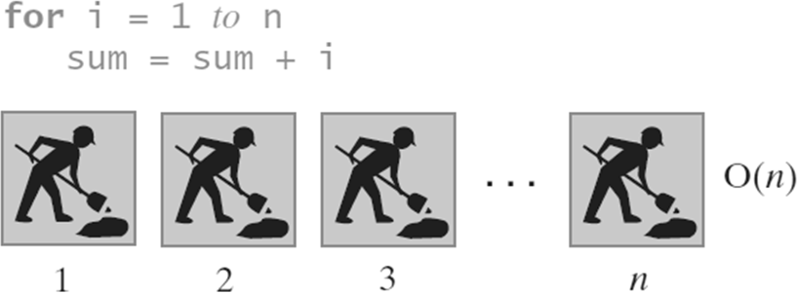
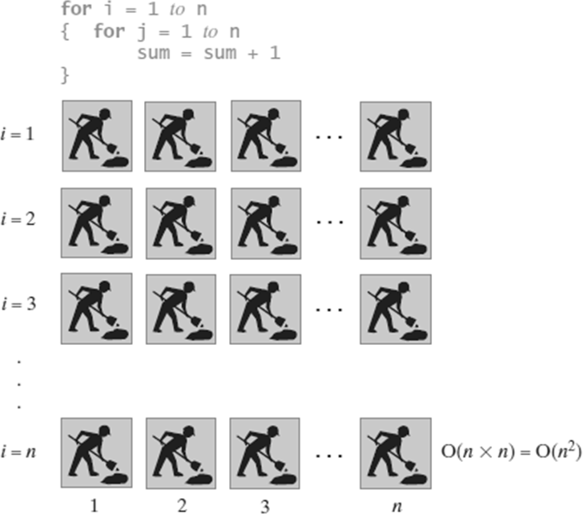
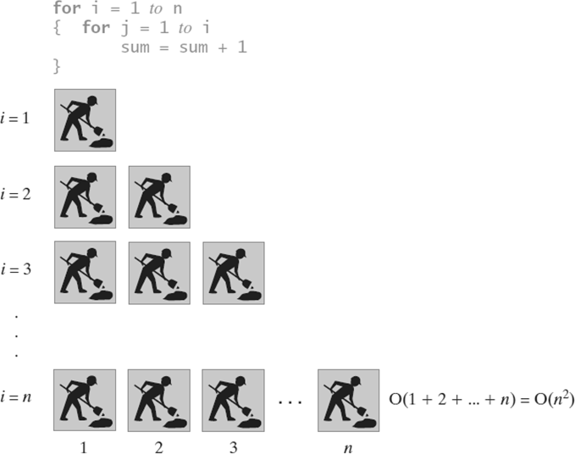
Picturing Efficiency – O(n) vs O(n²)

Slide 22
Where are we?
1
2
CODE
RUNTIME
FUNCTION
COMPLEXITY
CLASS
Code Modeling
Asymptotic Analysis
for (i = 0; i < n; i++) {
a[i] = 1;
b[i] = 2;
}
f(n) = 2n
O(n)
We just turned a piece of code into a function!
We’ll look at better alternatives for code modeling later
Now to focus on step 2, asymptotic analysis

Slide 23
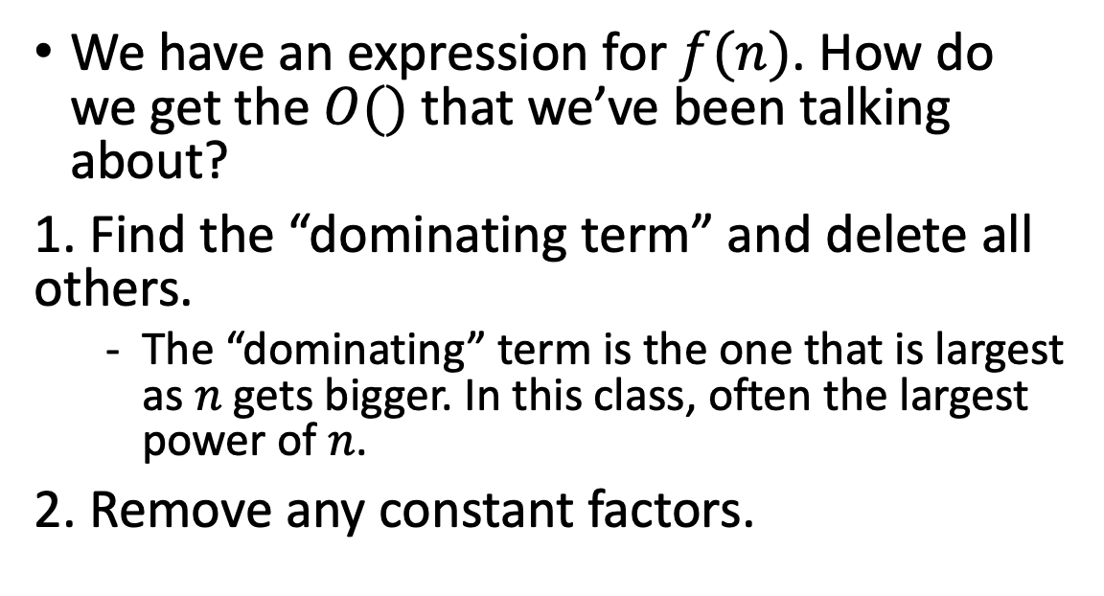
Finding a Big-Oh
2
RUNTIME
FUNCTION
COMPLEXITY
CLASS
Asymptotic Analysis
We have an expression for $f(n)$. How do we get the $O()$ that we’ve been talking about?
1. Find the “dominating term” and delete all others.
The “dominating” term is the one that is largest as $n$ gets bigger. In this class, often the largest power of $n$.
2. Remove any constant factors.
f(n) = (9n+3)n + 3
= 9n² + 3n + 3
≈ 9n²
≈ n²
f(n) is O(n²)
Notes:
Asymptotic Analysis works for any function

Slide 24
Is it okay to throw away all that info?
Big-Oh is like the “significant digits” of computer science
Asymptotic Analysis: Analysis of function behavior as its input approaches infinity
We only care about what happens when n approaches infinity
For small inputs, doesn’t really matter: all code is “fast enough”
Since we’re dealing with infinity, constants and lower-order terms don’t meaningfully add to the final result. The highest-order term is what drives growth!
Remember our goals:
A
Simple
We don’t care about tiny differences in implementation, want the big picture result
Decisive
Produce a clear comparison indicating which code takes “longer”
C

Slide 25
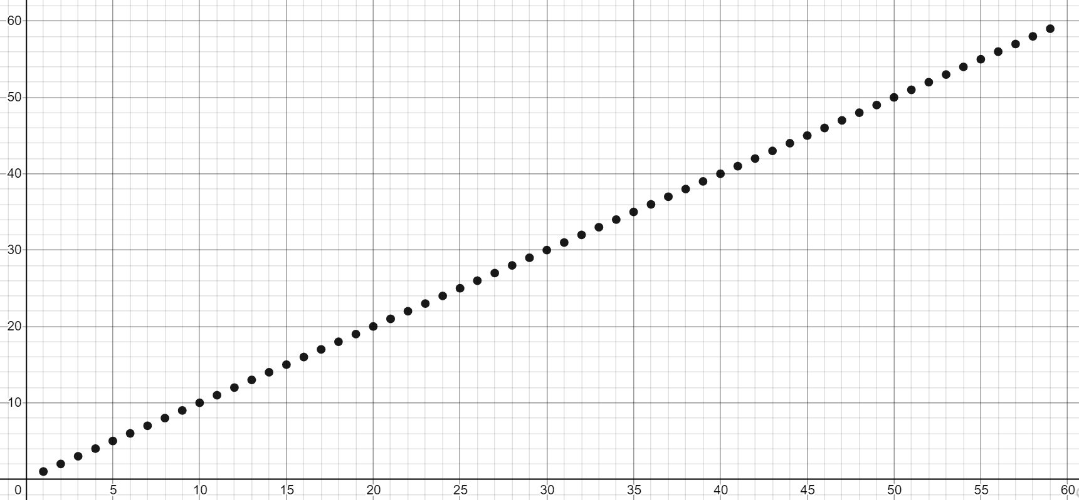
No seriously, this is really okay?
There are tiny variations in these functions (2n vs. 3n vs. 3n+1)
But at infinity, will be clearly grouped together
We care about which group a function belongs in
Let’s convince ourselves this is the right thing to do:
https://www.desmos.com/calculator/t9qvn56yyb

Slide 26
Using Formal Definitions
If analyzing simple or familiar functions, don’t bother with the formal definition. You can be comfortable using your intuition!
You’re going to be making more subtle big-O statements in future classes like COMP 482.
We need a mathematical definition to be sure we know exactly where we are.
You’re going to learn how to use the formal definition, so if you come across a weird edge case, you know how to get your bearings.
B
Mathematically Rigorous
Use mathematical functions as a precise, flexible basis

Slide 27
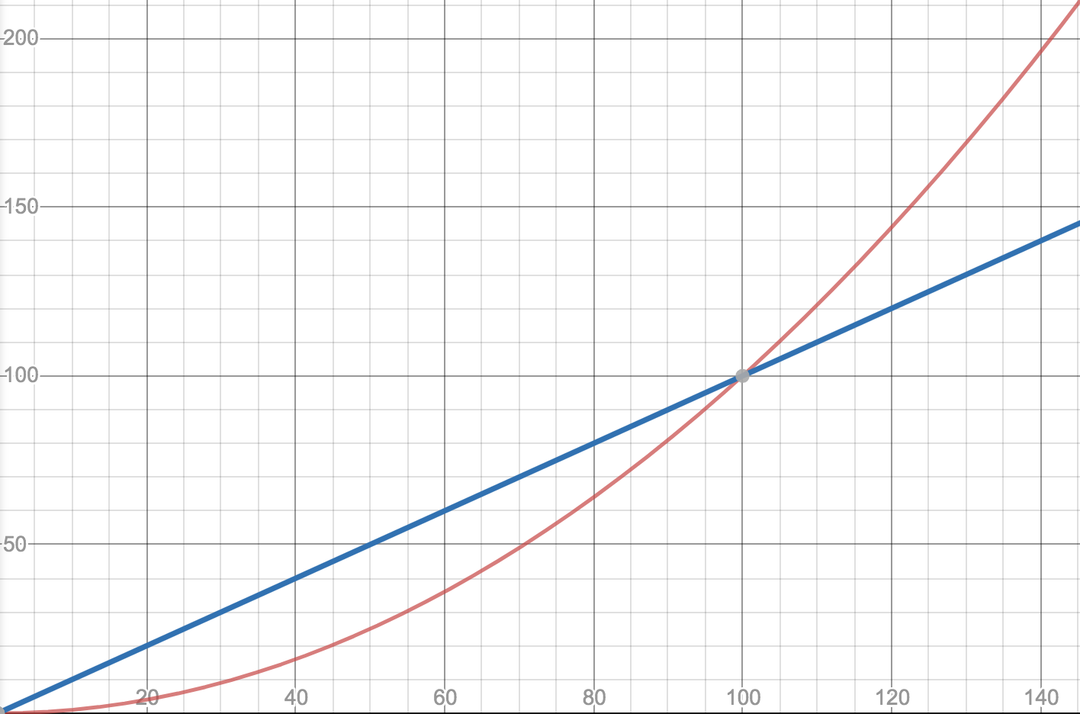
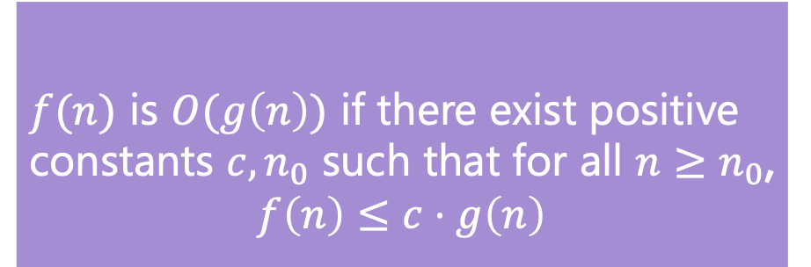
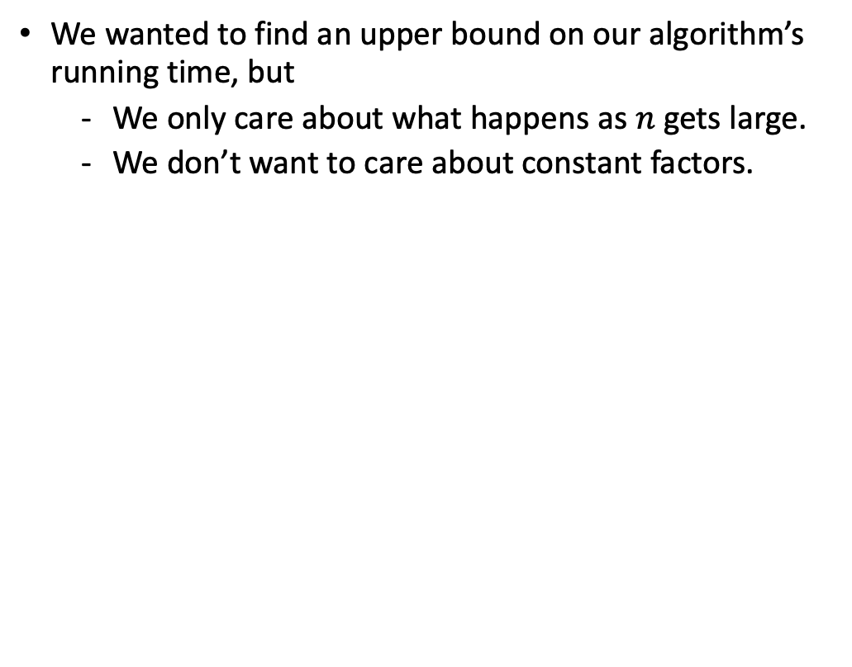
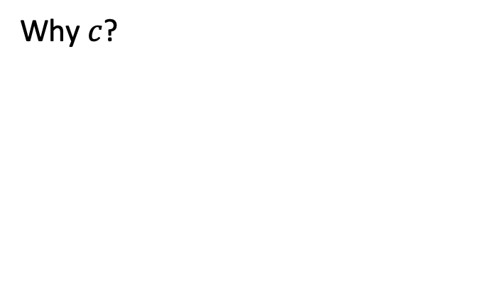

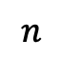

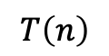
Big-Oh Definition
Why $n_{0}$?
f1(n)=0.01n²
We wanted to find an upper bound on our algorithm’s running time, but
We only care about what happens as $n$ gets large.
We don’t want to care about constant factors.
f2(n)=n
$f(n)$ is $O(g\left(n\right))$ if there exist positive constants $c, n_{0}$ such that for all $n≥n_{0}$,
$$f\left(n\right)≤c⋅g\left(n\right)$$
Big-Oh
Why $c$?
$$T\left(n\right)$$
We also say that $g\left(n\right)$ “dominates” $f(n)$
f1(n)=5n
$$n$$
f2(n)=n

Slide 28
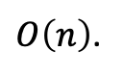
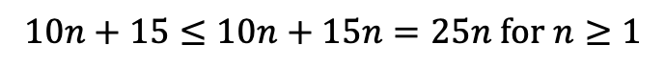
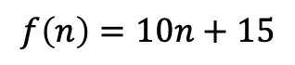
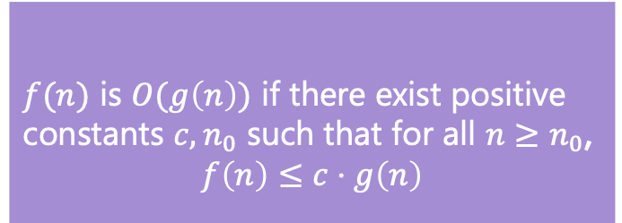
Big-Oh Proofs
$f(n)$ is $O(g\left(n\right))$ if there exist positive constants $c, n_{0}$ such that for all $n≥n_{0}$,
$$f\left(n\right)≤c⋅g\left(n\right)$$
Big-Oh
Show that
$$f\left(n\right)=10n+15$$
is
$O\left(n\right)$.
Apply definition term by term
$$10n≤c・n when c=10 for all values of n. So 10n≤10n$$
$15≤c・n when c=15 for n≥1.$ $So 15≤15n$
Add up all your truths
$$10n+15≤10n+15n=25n for n≥1$$
10n + 15 <= 25n for n >= 1.
which is in the form of the definition
f(n) <= c * g(n)
where c = 25 and n₀ = 1.

Slide 29
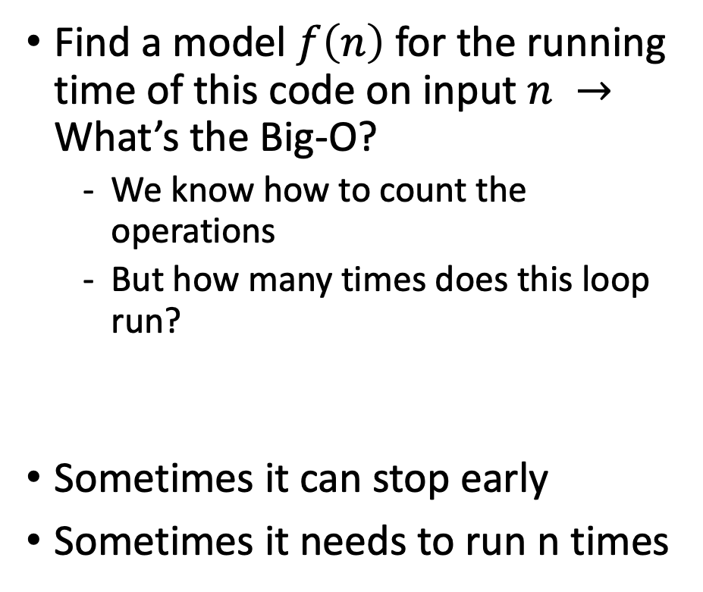
Uncharted Waters: Prime Checking
Find a model $f\left(n\right)$ for the running time of this code on input $n →$ What’s the Big-O?
We know how to count the operations
But how many times does this loop run?
Sometimes it can stop early
Sometimes it needs to run n times
boolean isPrime(int n) {
int toTest = 2;
while(toTest < n) {
if (n % toTest == 0) {
return true;
} else {
toTest += 1;
}
}
return false;
}
+1
+1
+2
+1
~+5
*?
+2
+1

Slide 30
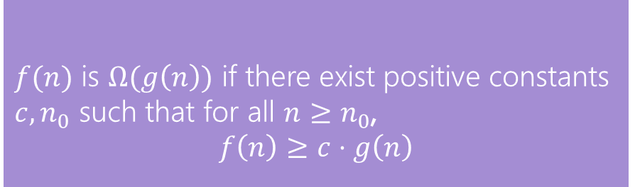
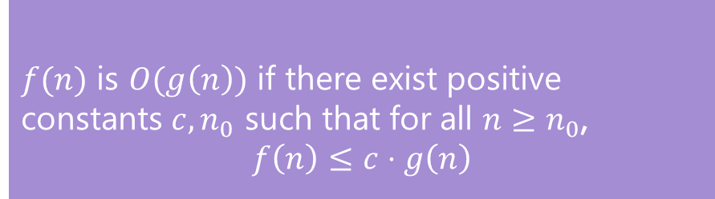
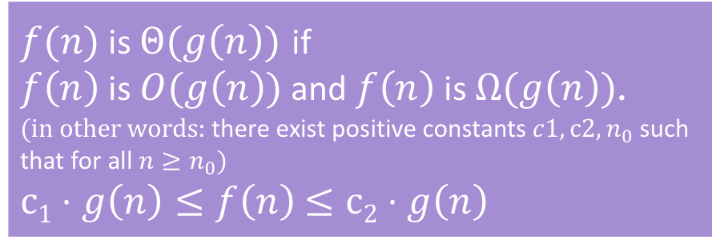
Oh, and Omega, and Theta
$f(n)$ is $O(g\left(n\right))$ if there exist positive constants $c, n_{0}$ such that for all $n≥n_{0}$,
$$f\left(n\right)≤c⋅g\left(n\right)$$
Big-Oh
Big-Oh is an upper bound
My code takes at most this long to run
Big-Omega is a lower bound
My code takes at least this long to run
Big Theta is “equal to”
My code takes “exactly”* this long to run
*Except for constant factors and lower order terms
Only exists when Big-Oh == Big-Omega!
$f(n)$ is $Ω(g\left(n\right))$ if there exist positive constants $c, n_{0}$ such that for all $n≥n_{0}$,
$$f\left(n\right)≥c⋅g\left(n\right)$$
Big-Omega
Big-Theta
$f(n)$ is $Θ(g\left(n\right))$ if
$f\left(n\right)$ is $O(g\left(n\right))$ and $f\left(n\right)$ is $Ω(g\left(n\right))$.
(in other words: there exist positive constants $c1, c2, n_{0}$ such that for all $n≥n_{0}$)
$c1⋅g\left(n\right)≤f\left(n\right)$ $≤c2⋅g\left(n\right)$

Slide 31
Case Study: Linear Search
Let’s analyze this realistic piece of code!
toFind
2
int linearSearch(int[] arr, int toFind) {
for (int i = 0; i < arr.length; i++) {
if (arr[i] == toFind) {
return i;
}
}
return -1;
}
arr
2 | 3 | 9 | 4 | 5
i
toFind
8
arr
2 | 3 | 9 | 4 | 5
What’s the first step?
We have code, so we need to convert to a function describing its runtime
Then we know we can use asymptotic analysis to get bounds
i

Slide 32
Let’s Model This Code!
int linearSearch(int[] arr, int toFind) {
for (int i = 0; i < arr.length; i++) {
if (arr[i] == toFind) {
return i;
}
}
return -1;
}
Same problem as before: How many times does loop run?
+2
+1
+1
+4
*?
+1
When would that happen?
Suppose the loop runs n times?
f(n) = 4n + 1
Suppose the loop only runs once?
f(n) = 4
toFind not present
These are key!
toFind at beginning

Slide 33
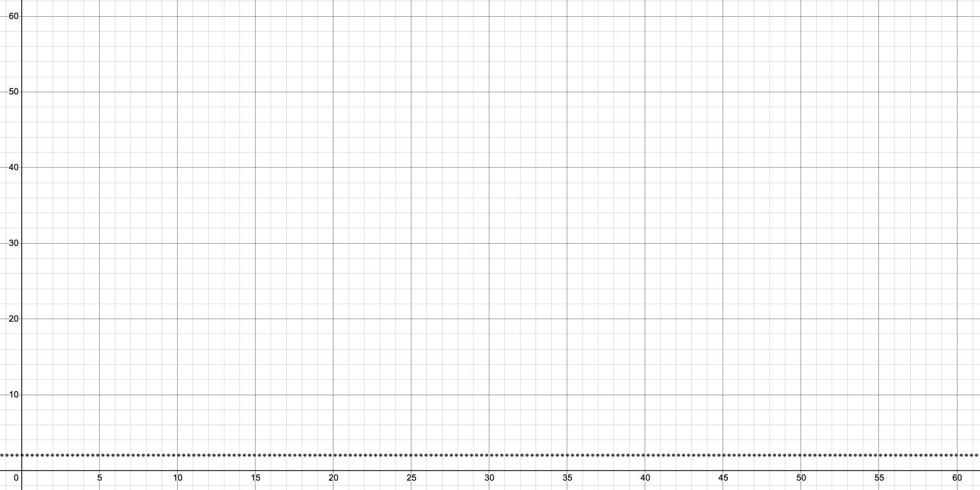

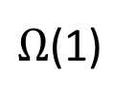
Best Case
Worst Case
On Lucky Earth
On Unlucky Earth
toFind
2
toFind
8
arr
2 | 3 | 9 | 4 | 5
arr
2 | 3 | 9 | 4 | 5
i
i
f(n) = 4
f(n) = 4n + 1
After asymptotic analysis:
After asymptotic analysis:
O(1)
Θ(1)
$Ω$(1)
O(n)
Θ(n)
$Ω$(n)
Notes:
Each case results in its OWN runtime function, which can then be fed into asymptotic analysis

Slide 34
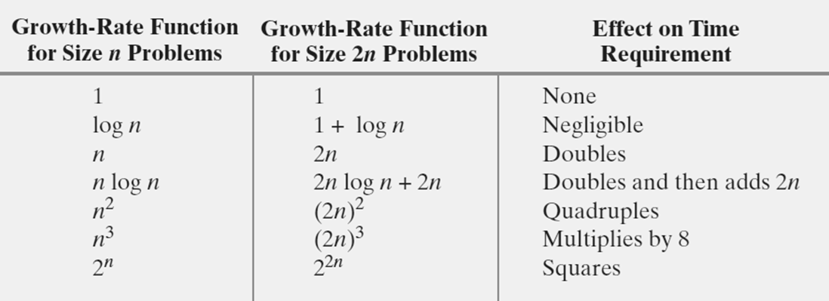
Effect of Doubling the Problem Size

Slide 35
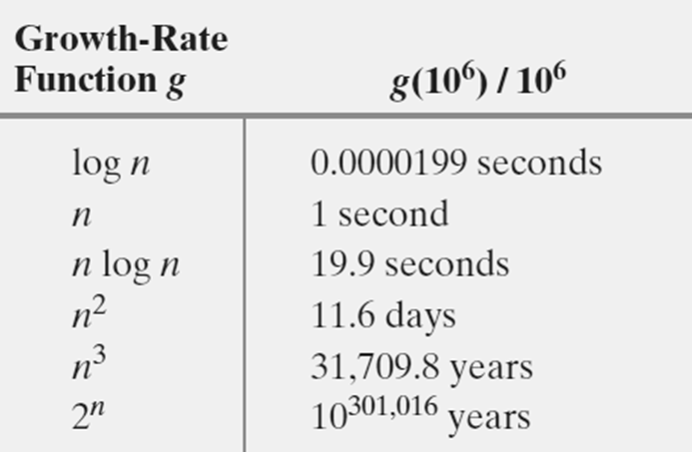
Time Required To Process One Million Items
Rate is one million operations per second
Notes:
Million Instructions per second (MIPS)
Cloud Amazon VMs: 50 – 1200 MIPS

Slide 36
YouTube Videos
Algorithms
Abdul Bari
https://www.youtube.com/watch?v=0IAPZzGSbME&list=PLDN4rrl48XKpZkf03iYFl-O29szjTrs_O
Videos #:
1,
1.1, 1.2, 1.3 (start from 2:00), 1.4,
1.5.1 – 1.5.3,
1.6,
1.7,
1.8.1 - 1.8.2,
1.9,
1.10.1 - 1.10.2,
1.11

Slide 37
End!

Slide 38
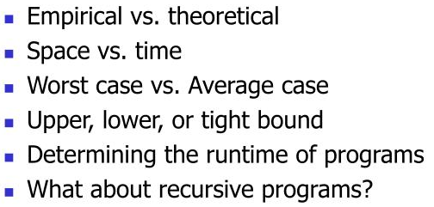
Algorithm Analysis

